Slide 1
ICT for Development
Session 1 & 2
Dr. Rajesh Sharma ITS
Department of Telecom
New Delhi

Slide 2
Recap of Session 1,2
Course objectives
Course outline
Project work
What is Development?
Economic theories and People-Centric theory of development
Criticism of economic theories
Developing vs. Developed countries
Human Development Index

Slide 3
Group Project Outline
Why was this project developed
What are the objectives of the project?
What is the project context? (policy environment, economic and social conditions, etc.)
What are the strengths (e.g. resources and capacities available) and weaknesses (e.g. vulnerable conditions) of the project?
What are the external opportunities and threats that affect the project?
What is the expected results of the project?
What are the achievements and impacts?
What are the methodologies and tools used in the project?
How was ICT applied in the project?
• How was the project managed? By whom?
What were the good practices, lessons learned and recommendations for future actions?
Source and References: Useful references for further information

Slide 4
What is Development?
The term means different things to different people, based on economic, geographic, political, social, cultural, religious and ethnic contexts.
Current development perspectives originated from
post World War II era when the term “development” was used as part of a rationale for post-war reconstruction in Europe and the “underdeveloped parts” of the world.
immediate post-colonial experience where most of the newly independent countries of Asia and Africa were, according to Western values, left far behind in terms of progress.
“Development” as a conceptual framework for a number of individual, institutional, national and international changes is essentially a post World War II phenomenon.
Became synonymous with growth, modernization, change, democracy, and many similar Western values, and in the beginning was focused largely on economic development.
Measured by economic indicators e.g. Gross National Product (GNP), GNP per capita, Gross Domestic Product (GDP) and GDP per capita and per capita income

Slide 5
Human Development Index
The HDI consists of three indices: life expectancy, education/literacy and standard of living to compare the level of development of a particular group of people (as in, developed, developing, underdeveloped) based on the availability of options.
The logic is that the more developed a group of people are, the more options are available to them.
Comparing HDI over a period of 20-30 years show that there have been improvements in all dimensions of human development in life expectancy, literacy and income levels.
However, the gap between developed countries and developing countries remains high.
Most developed countries have HDIs of 0.8 or higher
Despite having the world's second-largest economy, China is still not classified as a developed country
lowest GDPs per capita
dependence on agriculture, (7.7% of China's overall GDP)
average life expectancy was 77 years, and its infant mortality rate was 11 per 1,000 live births. ﻿

Slide 6
Role of ICT in Development
ICTs have provided citizens with new opportunities and resources
e-Government extends the reach of public services
social media provides voices to those social groups most often marginalized
e-Health brings medical practitioners to rural communities
online learning provides access to education for those outside traditional hubs of learning
Play an important role in fostering improved connectivity as well as socio-economic development throughout the world.
Challenges: Digital Divide
Considerable inequalities in terms of ICT infrastructure, connectivity and know-how still exist & inhibit the potential benefits of ICTs from being adequately leveraged.
Access to ICTs is not uniform across regions, countries and communities, with many significant discrepancies existing between neighboring regions and the social groups within them.

Slide 7
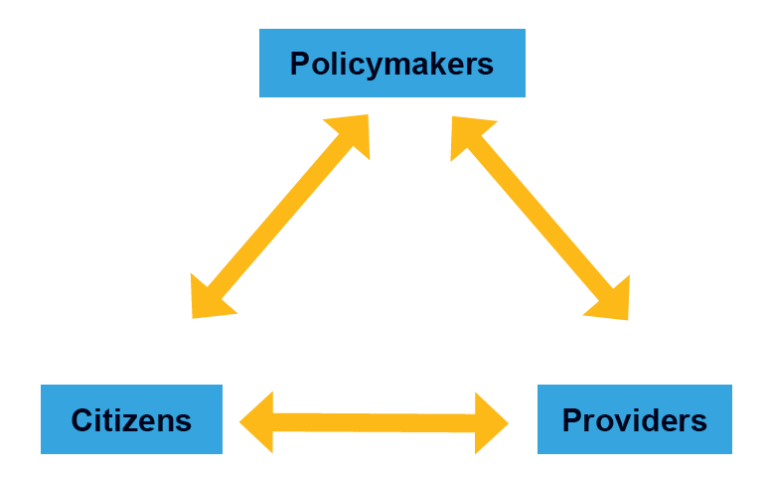
Stakeholders in ICT for Development

Slide 8
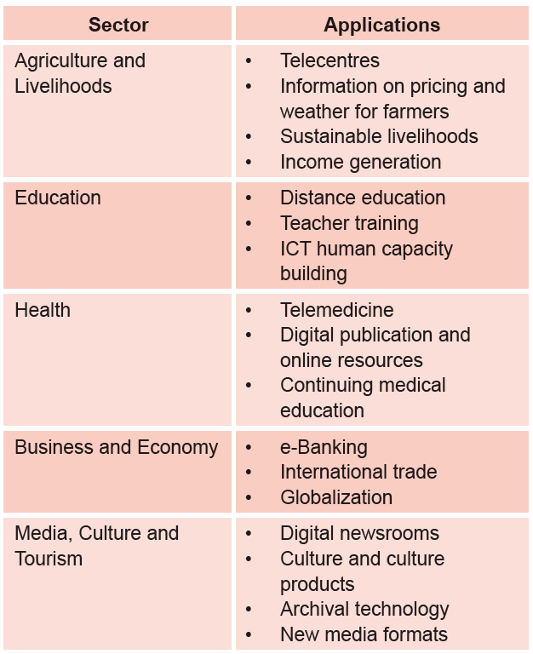
Role of ICT in Development

Slide 9
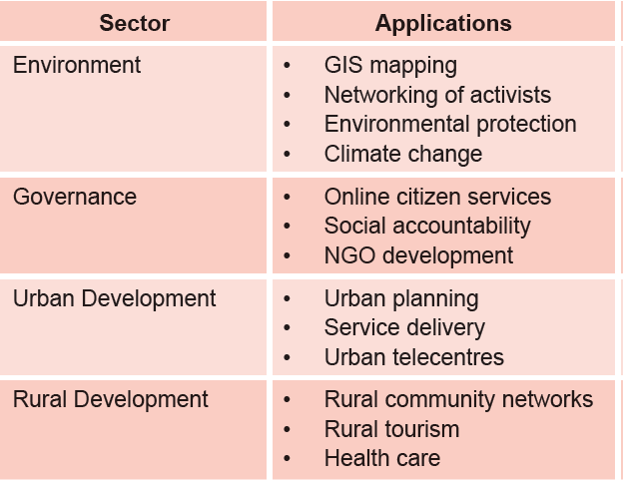
Role of ICT in Development

Slide 10
Millennium Development Goals
Millennium Development Goals (MDGs) were the eight international development goals for the year 2015 that had been established following the Millennium Summit of the United Nations in 2000.
All 189 United Nations member states at the time and 23 international organizations, committed to help achieve Millennium Development Goals by 2015:
To eradicate extreme poverty and hunger
To achieve universal primary education
To promote gender equality and empower women
To reduce child mortality
To improve maternal health
To combat HIV/AIDS, malaria, and other diseases
To ensure environmental sustainability
To develop a global partnership for development

Slide 11
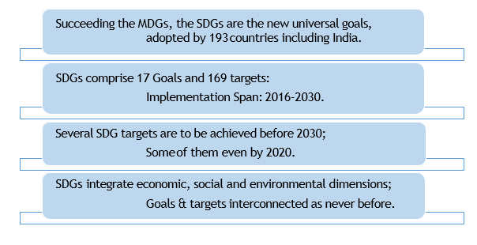
Sustainable Development Goals
At the United Nations Sustainable Development Summit on 25/09/15, world leaders adopted the 2030 Agenda for Sustainable Development, which includes a set of 17 Sustainable Development Goals (SDGs) to end poverty, fight inequality and injustice, and tackle climate change by 2030.

Slide 12


Slide 13
SDG Categorization
Social SDG 1 - No Poverty SDG 2 - Zero Hunger SDG 3 - Good Health and Well-Being SDG 4 - Quality Education SDG 5 - Gender Equality SDG 6 - Clean Water and Sanitation | Environmental SDG 12-Sustainable Consumption and Production SDG 13- Climate Action SDG 14- Life Below Water SDG 15- Life on Land
Economic SDG 7- Affordable and Clean Energy SDG 8- Decent Work and Economic Growth SDG 9- Industry, Innovation and Infrastructure SDG 10 – Reduced Inequalities SDG 11- Sustainable Cities and Communities | Fostering Peace and Partnership SDG16- Peace, Justice and Strong Institutions SDG 17- Partnerships for the Goals

Slide 14
Sustainable Development Goals
Goal 1 | End poverty in all its forms everywhere | Goal 10 | Reduce inequality within and among countries
Goal 2 | End hunger, achieve food security and improved nutrition and promote sustainable agriculture | Goal 11 | Make cities and human settlements inclusive, safe, resilient and sustainable
Goal 3 | Ensure healthy lives and promote well-being for all at all ages | Goal 12 | Ensure sustainable consumption and production patterns
Goal 4 | Ensure inclusive and equitable quality education and promote lifelong learning opportunities for all | Goal 13 | Take urgent action to combat climate change and its impacts
Goal 5 | Achieve gender equality and empower all women and girls | Goal 14 | Conserve and sustainably use the oceans, seas and marine resources for sustainable development
Goal 6 | Ensure availability and sustainable management of water and sanitation for all (6.a, 6.b) | Goal 15 | Protect, restore and promote sustainable use of terrestrial ecosystems, sustainably manage forests, combat desertification, and halt and reverse land degradation and halt biodiversity loss
Goal 7 | Ensure access to affordable, reliable, sustainable and modern energy for all | Goal 16 | Promote peaceful and inclusive societies for sustainable development, provide access to justice for all and build effective, accountable and inclusive institutions at all levels
Goal 8 | Promote sustained, inclusive and sustainable economic growth, full and productive employment and decent work for all | Goal 17 | Strengthen the means of implementation and revitalize the global partnership for sustainable development
Goal 9 | Build resilient infrastructure, promote inclusive and sustainable industrialization and foster innovation

Slide 15
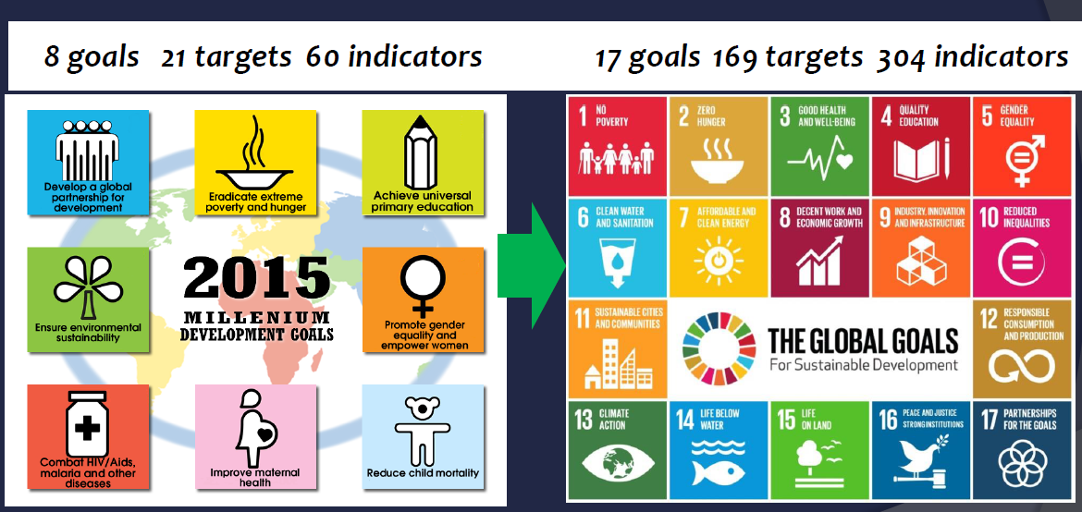
MDG & SDG Comparison

Slide 16
MDGs to SDGs: Strategic Shifts
MDG | SDG
Traditional assistance | Traditional assistance + Universal goals
Limited goals | More comprehensive
Top-down process | Inclusive goal setting
Traditional statistics | Traditional + Data revolution
Hunger and poverty together | Distinction
Quantity Education | Quality Education
Funding: Focus on ODA | Broader set of financial sources

Slide 17
MDGs to SDGs: Strategic Shifts
Conclusiveness – Focus on the Finish line: Zero Poverty, Hunger, preventable Child Deaths, Gender Discrimination & Violence, etc.
Comprehensiveness - The SDGs are more comprehensive with fuller array of targets, better focus on causality and strategic issues.
Universality – Applicable to all countries, with greater emphasis on the responsibility of the developed countries,
Inclusiveness – Clear focus on ‘leaving no one behind and reaching the furthest behind first.
Hunger distinct from Poverty – deeper analysis of structural and social factors separates poverty from food and nutrition security.
Peace Building – Addressing conflict resolution and peace building as enablers of growth and development
Resourcing –
Focus on sustainable economic development in a country to meet financial resource requirement for achieving SDGs;
Holistic approach to international financing of SDGs – Stronger focus on ODA, international resource flows, technology transfer and trade
Measurability – Clear emphasis on monitoring, evaluation and accountability, and the metrics - high-quality, up-to-date and reliable data

Slide 18
Indicators of SDGs
S. No. | SDGs | No. of Indicators | Focus Areas of Indicators
1 | No Poverty | 5 | population below poverty line & poverty gap ratio,
 |  |  | employment under MGNREGA,
 |  |  | Access to safe drinking water & Sanitation
2 | Zero Hunger | 5 | Access to food grains at subsidized prices
 |  |  | Stunting & wasting in under-5 children
 |  |  | Agricultural productivity & Gross Value Added per worker
3 | Good Health and Well-Being | 9 | Maternal Mortality Ratio; Neo-natal & Under-5 Mortality Rates
 |  |  | Immunisation of under-2 children
 |  |  | Incidence of HIV/AIDS, malaria & TB
 |  |  | Medical personnel per 10,000 people
4 | Quality Education | 4 | Net Enrolment Ratio & Out of School Ratio
 |  |  | Enrolment Ratio of Children with disabilities
 |  |  | Pupil Teacher Ratio

Slide 19
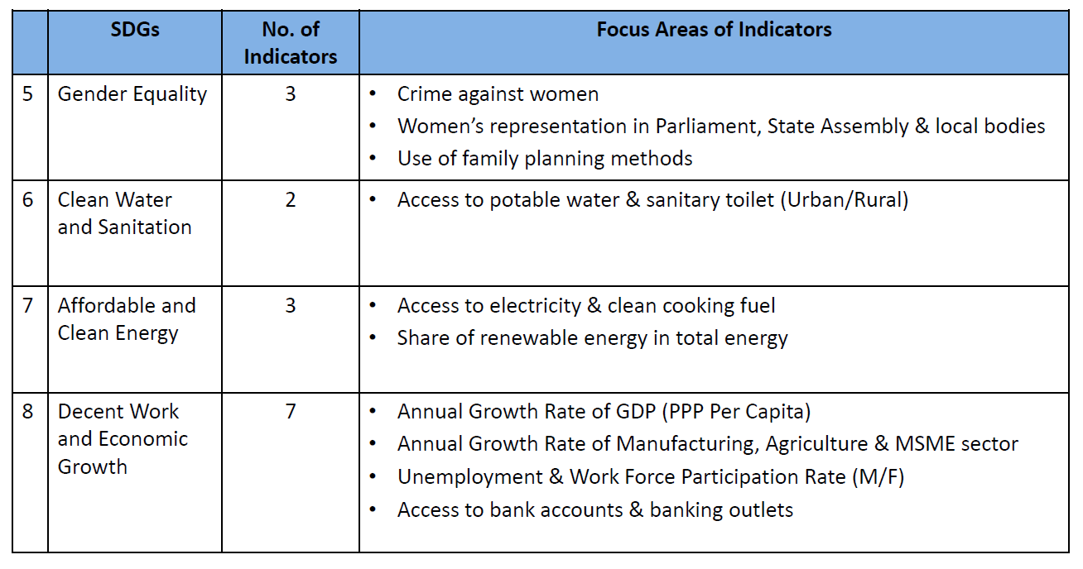
Indicators of SDGs

Slide 20
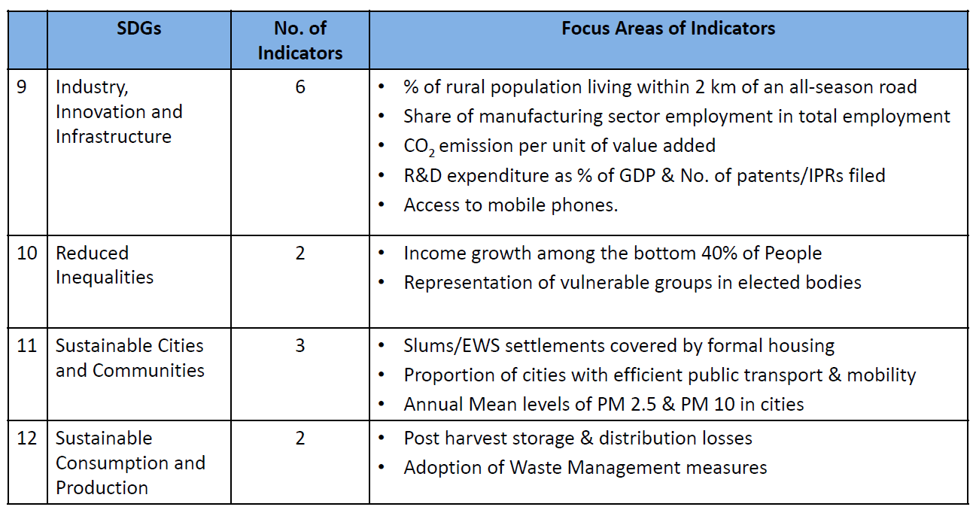
Indicators of SDGs

Slide 21
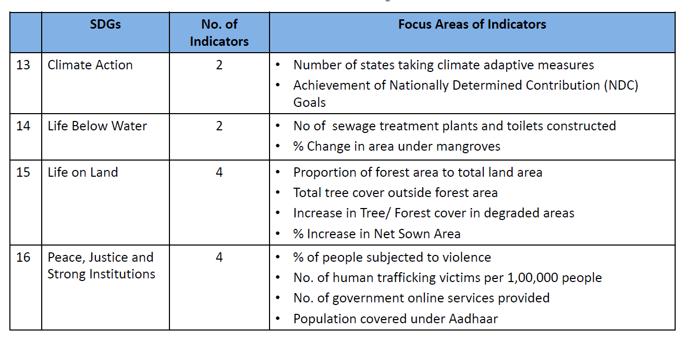
Indicators of SDGs

Slide 22

Role of ICT in SDGs
ICTs are catalytic drivers to enable the achievement of all the SDGs
“ The spread of information and communication technology and global interconnectedness has great potential to accelerate human progress, to bridge the digital divide and to develop knowledge societies, as does scientific and technological innovation across areas as diverse as medicine and energy”.
Agenda for Sustainable Development (Paragraph 15)

Slide 23
References to ICT in SDGs
While none of the SDGs is specifically about ICTs, several targets make references to ICTs and technology.
ITU has made a concerted effort to highlight the role that ICTs will play in achieving the SDGs. It is actively participating in the discussions on the indicators that will be used to track the SDGs.
Link to UN Global Indicators for SDGs
https://unstats.un.org/sdgs/indicators/indicators-list/
Click here for Excel file with all SDG targets

Slide 24
Role of ICT in SDGs
The February 2016 version of the IAEG-SDGs(Inter-agency and Expert Group on SDGs) report includes the following 7 ICT indicators covering 6 targets under Goals 4, 5, 9, and 17. (The organization indicated in brackets tracks the indicator at the international level).
Proposed SDG indicators related to ICTs
Target 4a: Proportion of schools with access to computers & Internet for pedagogical purposes (UIS)
Target 4.4: Proportion of youth/adults with ICT skills, by type of skills (ITU)
Target 5b: Proportion of individuals who own a mobile telephone, by sex (ITU)
Target 9c: Percentage of the population covered by a mobile network, broken down by technology (ITU)
Target 17.6: Fixed Internet broadband subscriptions, broken down by speed (ITU)
Target 17.8: Proportion of individuals using the Internet (ITU)

Slide 25
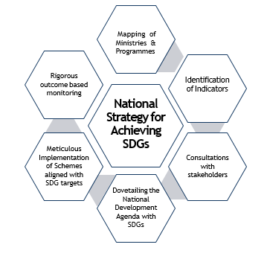
NITI Aayog’s Strategy for SDGs in India

Slide 26
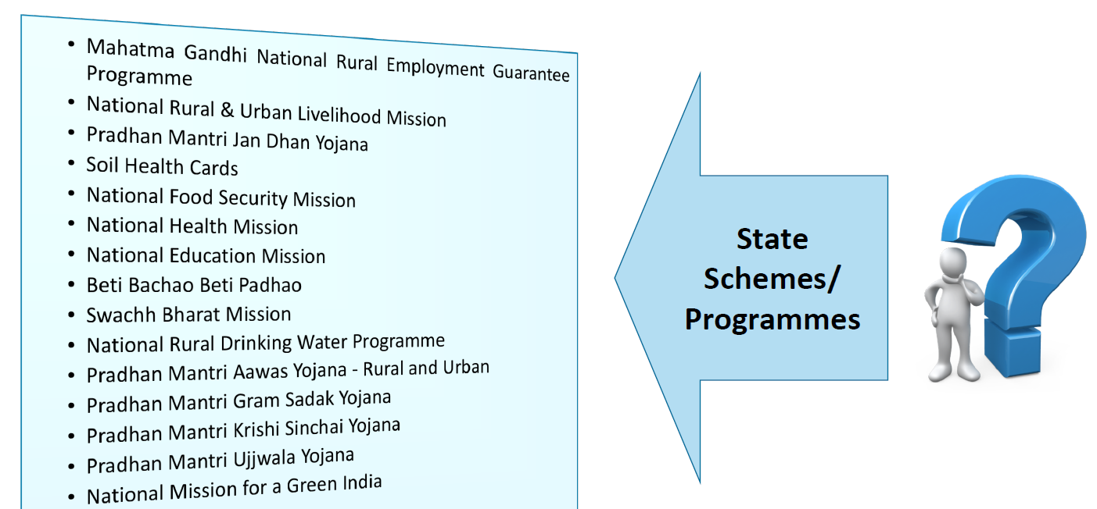
Mapping of National Programs with SDGs

Slide 27
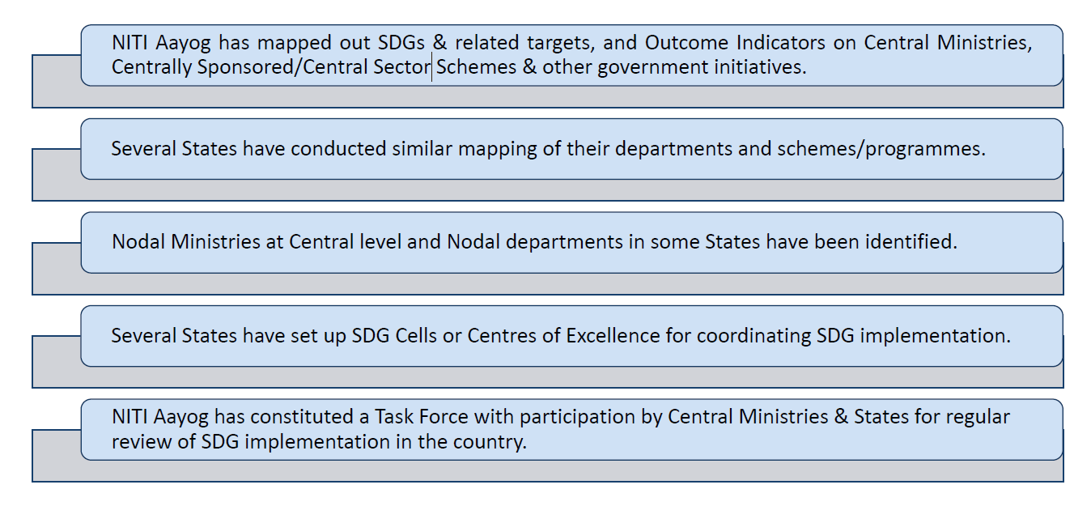
Integration of Programs with SDGs

Slide 28
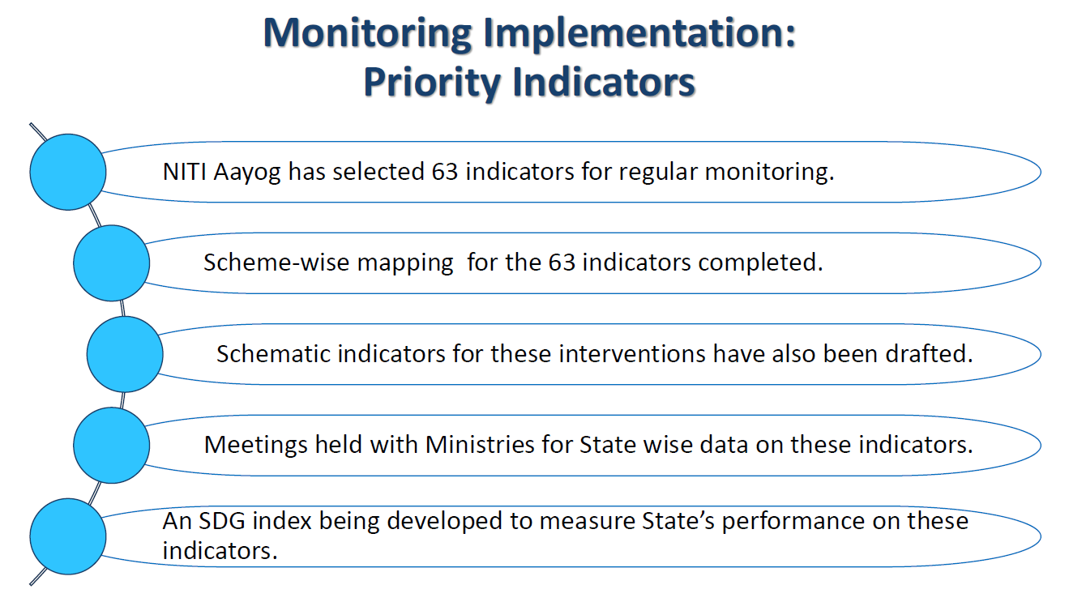

Slide 29
The ICT Development Index (IDI)
Methodology, indicators and definitions

Slide 30
The ICT Development Index (IDI)
The IDI is a composite index that combines 14 indicators
Designed to be global and reflect changes taking in place in countries of different levels of development
Was developed by ITU in 2008 in response to
member states’ request to establish an overall ICT index
Results first reported in the Measuring the Information Society Report (MISR) 2009

Slide 31
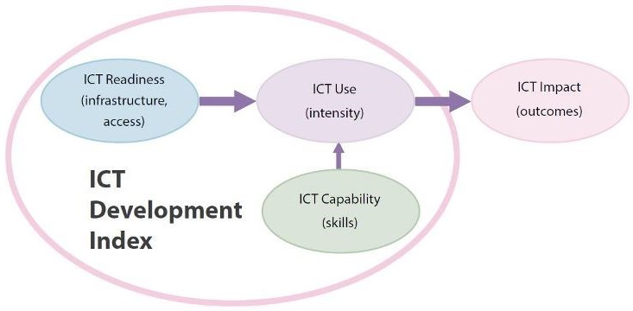
Three stages in the evolution of IDI

Slide 32
IDI
ICT Development Index (IDI) is published by International Telecommunication Union (ITU) based on internationally agreed Information and Communication Technology (ICT) indicators.
IDI is a standard tool that governments, operators, development agencies, researchers and others can use to measure the digital divide and compare ICT performance within and across countries.

Slide 33
IDI Indicators
IDI is based on 11 ICT indicators, grouped in 3 clusters: ICT access, ICT use and ICT skills sub indices.
For computation of the final Index, the ICT access and ICT usage sub-indices were each given a 40 per cent weighting, and the skills sub-index 20 per cent weighting.
The final Index value was then computed by summation of the weighted sub-indices.

Slide 34
IDI Indicators
Access sub-index: This sub-index captures ICT readiness, and includes five infrastructure and access indicators
fixed-telephone subscriptions
mobile-cellular telephone subscriptions
international Internet bandwidth per Internet user
households with a computer
households with Internet access

Slide 35
IDI Indicators
Use sub-index: This sub-index captures ICT intensity, and includes three intensity and usage indicators
individuals using the Internet
fixed-broadband subscriptions
mobile-broadband subscriptions

Slide 36
IDI Indicators
Skills sub-index: This sub-index seeks to capture capabilities or skills that are important for ICTs. It includes three proxy indicators
mean years of schooling
gross secondary enrolment
gross tertiary enrolment.
As these are proxy indicators, rather than directly measuring ICT-related skills, the skills sub-index is given less weight in the computation of the IDI than the other two sub-indices

Slide 37
IDI Rankings
As per ITU’s Measuring the Information Society Report (MISR)-2017, Iceland tops the IDI rankings with an IDI value of 8.98 followed by South Korea, Switzerland and Denmark. India ranks 134 with IDI value at 3.03 among 176 countries.
But seeing the rapidly growing Indian economy, more than 1000 million mobile users, growing size of population and global status in IT/ITes, present ranking at 134 is not fair and needed huge improvement.
NDCP-2018 has the objective to improve the ranking within top 50.

Slide 38
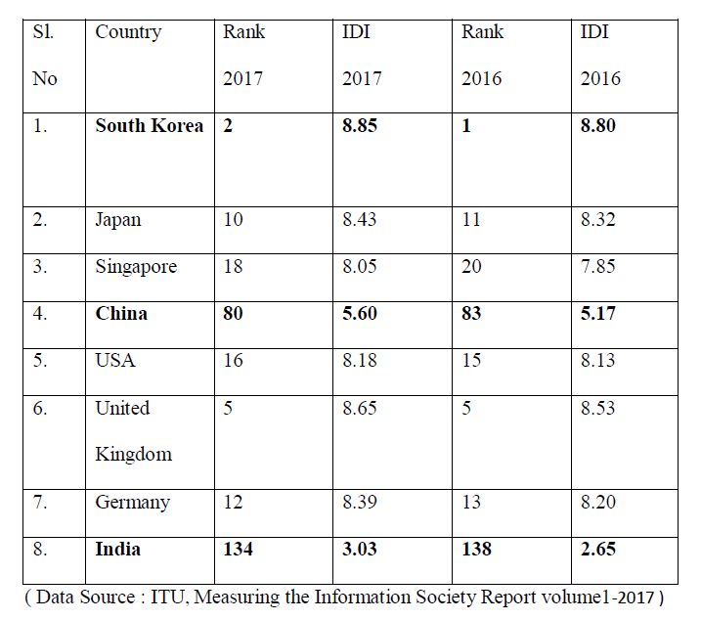
IDI Rankings

Slide 39
Objectives of the IDI
To measure:
the level and evolution over time of ICT developments in countries and the experience of those countries relative to other countries;
progress in ICT development in both developed and developing countries;
the digital divide, i.e. differences between countries in terms of their levels of ICT development; and
the development potential of ICTs and the extent to which countries can make use of them to enhance growth and development.

Slide 40
What is e-Government?
OECD (2003): “Use of information and communication technologies, and particularly the Internet, as a tool to achieve better government .”
World Bank: “Use of information technologies (such as Wide Area Networks, the Internet, and mobile computing) by government agencies that have the ability to transform relations with citizens, businesses, and other arms of government”.
United Nations (2014): "The use and application of information technologies in public administration to streamline and integrate workflows and processes, to effectively manage data and information, enhance public service delivery, as well as expand communication channels for engagement and empowerment of people.”
SCOPE OF ACTIVITIES IN e-GOVERNMENT EXPANDING WITH TIME

Slide 41
Why e-Government?
Governments all over the world are adopting Information and Communication Technology (ICT) for transforming government administration (Dwivedi et al. 2012; Ebrahim & Irani 2005)
Mode of delivery that has the potential for
reducing the governance costs by minimizing the wastage (Janssen et al. 2008).
eliminating corruption by improving transparency (Krishnan et al. 2013).
promising a better future to the citizens by opening up opportunities for reduction in rural poverty and inequality (Soriano 2007).
Accordingly, huge investments are being made in promoting e-Government with the objective of achieving effective delivery of government services.

Slide 42
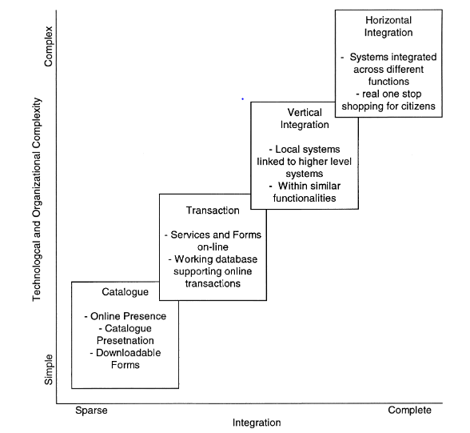
Four Stage Maturity Model of e-Government
Source: Layne & Lee (2001)

Slide 43
Challenges
Digital infrastructure.
Building IT applications.
Digital literacy.
Government Process Re-engineering.
Interoperability of diverse IT systems.
Change management at user & organizational levels.
Information security.

Slide 44
Thank you!
Email: rajesh.sharma25@gov.in
Cell: 9868131220

